Slide 1
Assignment

Slide 2
Chapter 1
Q)1.22 (b, c)
Using data of questions 1.18 and 1.19
a) Construct relative frequency distribution b) Find class boundaries and midpoints
c) Construct cumulative frequency distribution
c) Construct a relative frequency histogram and discuss the
skewness of the distribution.

Slide 3
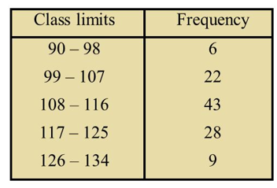
For randomly selected college applicants, the following frequency distribution for entrance exam scores was obtained.
Construct histogram, relative frequency polygon and ogive

Slide 4
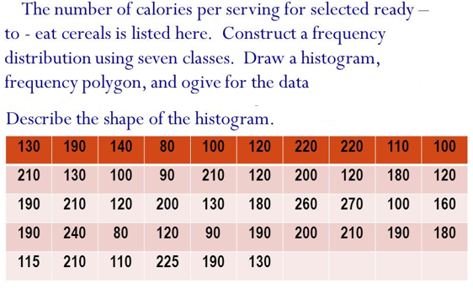

Slide 5
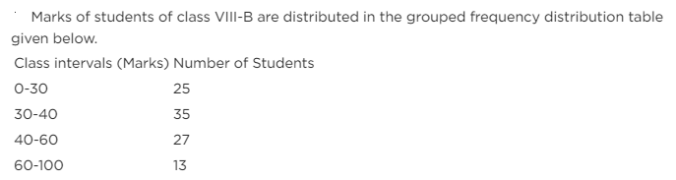
Construct histogram

